Slide 1
SCF8 Argus Project Short report
Dr. A. Bohren
SPF Testing

Slide 2
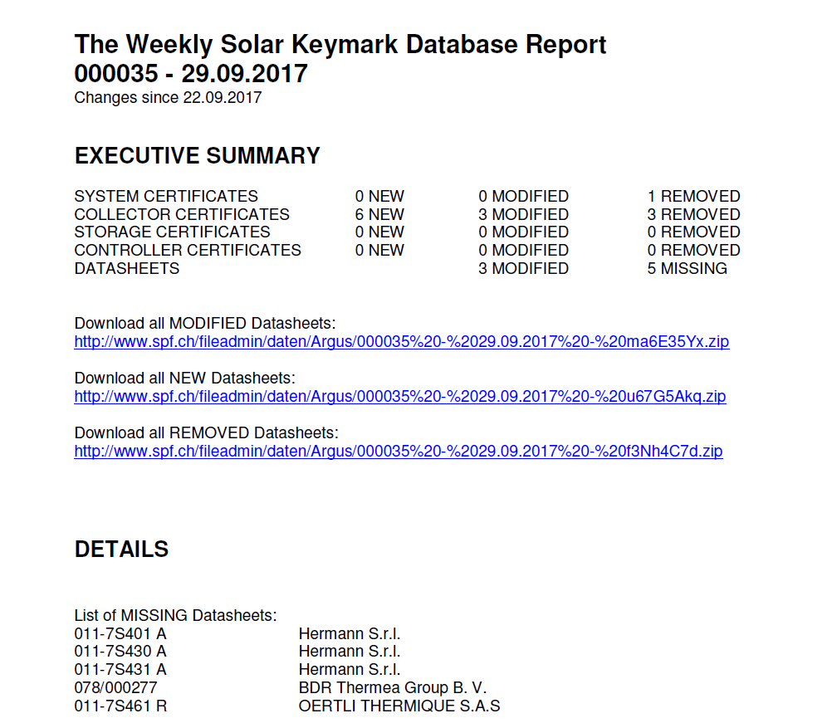
The weekly solar keymark database report

Slide 3
The weekly solar keymark database report
Every week since April 2017 information about all changes in the SK Database.
Every 3 months a quarterly report for subscribers.
Currently about 1000 emails/week.
Will stay for free for the time being.
Only very few datasheets are missing.
Register under www.spf.ch/Argus.html

